Slide 1
ECE-593: Fundamentals of Pre-Silicon Validation
Multiprocessor System Verification
Milestone 5 Final Deliverables & Presentation
Team Members: Janvier Mpfizi Rutihunza • Frezewd Debebe • Sal Esmaeil
Instructor: Prof. Venkatesh Patil | Portland State University | Winter 2026
5
10+
13
3
Milestones
UVM Components
Opcodes Verified
Bug Scenarios
Notes:
Good Evening, everyone. I'm Sal, and together with my teammates Janvier and Frezewd, we've been working on Milestone 5 — the final deliverable for our multiprocessor system verification project. Today we'll walk you through our UVM testbench architecture, our bug injection strategy, and our coverage results.

Slide 2
Project Overview
OBJECTIVE Design and verify a multiprocessor system with shared memory architecture using UVM-based verification methodology
KEY FEATURES
Shared-memory multiprocessor architecture
Centralized round-robin arbiter for bus access
Cache and memory subsystem for data storage
Transaction-based verification using UVM
VERIFICATION GOALS
Multi-core memory access correctness
Bus arbitration between processors
Data integrity during read/write operations
100% functional coverage closure
Notes:
This project focuses on designing and verifying a multiprocessor system where several processor cores share the same memory.
The cores communicate through a shared bus controlled by a centralized arbiter to ensure fair access.
A shared cache and memory subsystem store the data used by the processors.
To verify the correctness of the system, we implemented a UVM-based verification environment that generates transactions, drives them to the design, and checks the outputs.

Slide 3
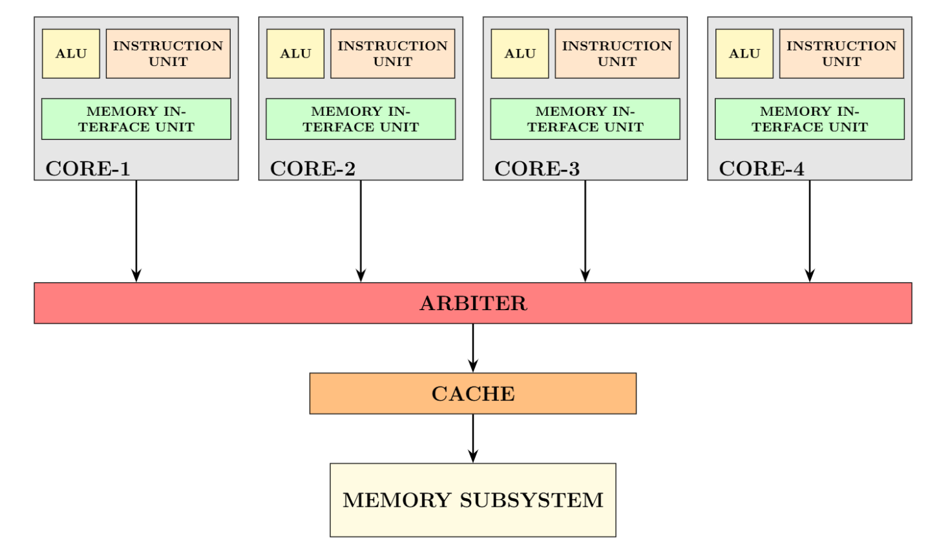
Multiprocessor System Architecture
Four processor cores (CORE-1 to CORE-4).
Each core contains:
Instruction Unit
ALU
Memory Interface Unit
Shared System Components
Shared Bus
Round-Robin Arbiter
Shared Cache
Memory Subsystem (2 KB)
Cache Organization
128 cache lines
16 bytes per line
Write-back policy
Ensures a single coherent copy of each memory block
Notes:
This slide shows the hardware architecture of the multiprocessor system. The system consists of four processor cores, each containing an instruction unit, an ALU, and a memory interface unit. All cores connect to a shared bus that provides access to the shared cache and memory subsystem. A centralized round-robin arbiter sits between the cores and the cache to control access to the bus. Below the arbiter is a shared cache, followed by the main memory subsystem. The cache contains 128 lines with 16 bytes per line and uses a write-back policy to improve memory performance and maintain data consistency

Slide 4
Milestone Roadmap
1
2
3
4
5
Project Setup
Design spec and architecture defined. Initial RTL structure created.
Class-Based TB
Driver, monitor, generator, scoreboard built. Initial tests executed.
Coverage-Driven
Additional test scenarios. Coverage gaps identified and targeted.
UVM Testbench
Agents, sequencer, driver, monitor integrated. Directed and random tests.
Bug Injection ★
Bug scenarios, coverage finalized. Final docs and presentation.
Notes:
Milestone 1 focused on project setup and system architecture. The team prepared the design specification and created the initial RTL structure.
Milestone 2 focused on building the class based verification environment. The team implemented the generator, driver, monitor, and scoreboard. Initial functional tests started in this phase.
Milestone 3 expanded coverage driven verification. The team added more test scenarios and targeted coverage gaps.
Milestone 4 introduced the UVM verification environment. Agents, sequencer, driver, and monitor were integrated. Directed and constrained random tests ran to validate the design.
Milestone 5 completed the verification process. The team added bug injection scenarios, finalized coverage reports, and prepared the final documentation and presentation.

Slide 5
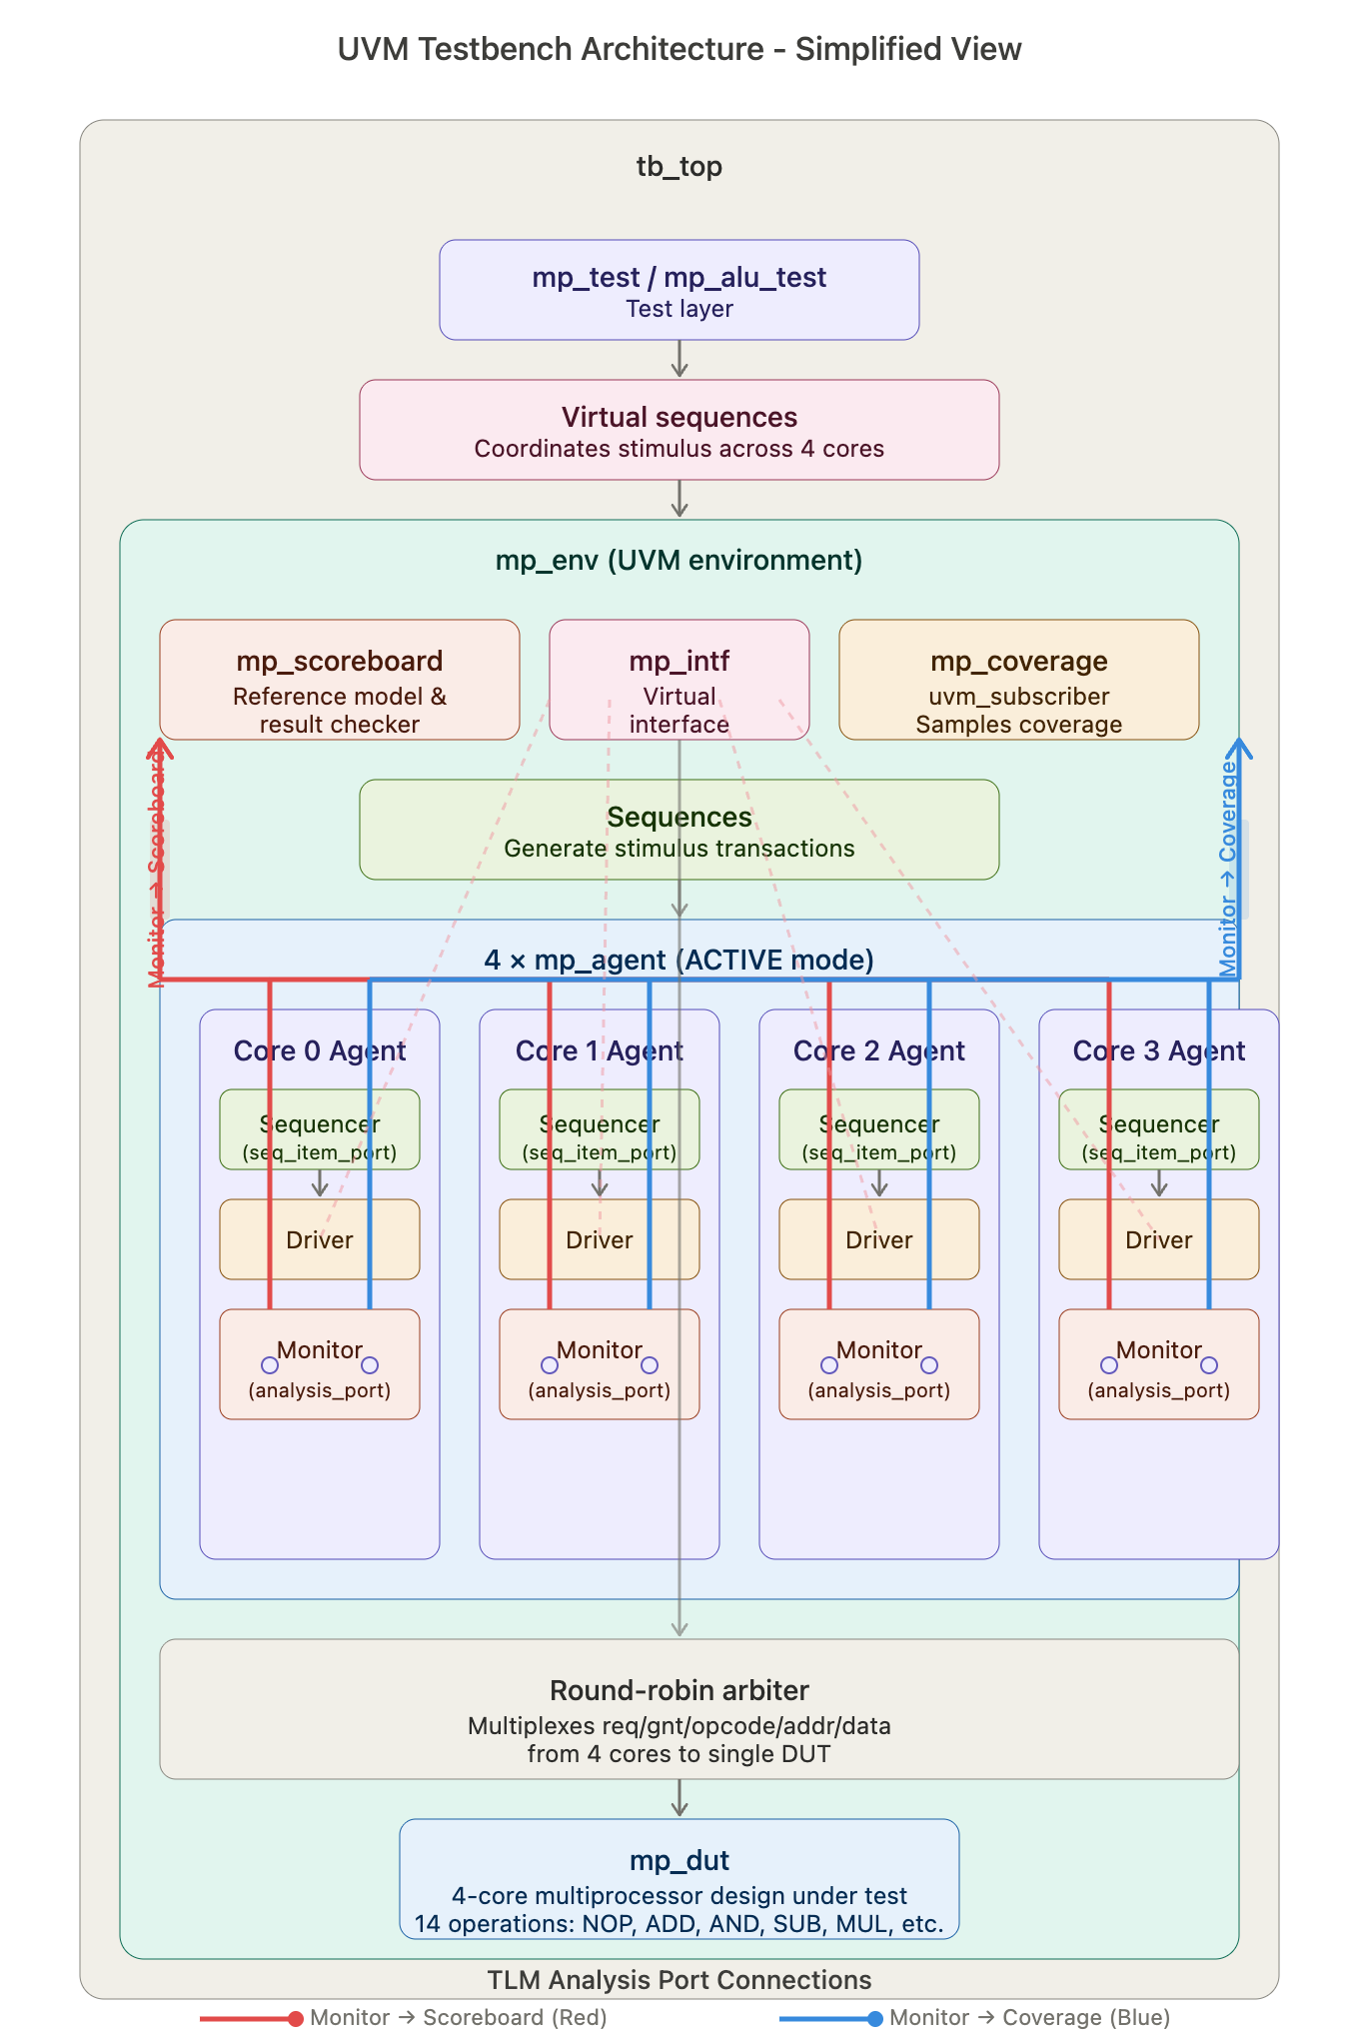
UVM Architecture
Test
Sequence: Defines specific test scenarios
Sequence_item: Represents a single operation sent to the DUT
Environment
Top container that connects all verification components
Scoreboard
Compares expected results with DUT output to detect errors
Agent
Sequencer: Manages order of sequence items
Driver: Converts transactions into DUT signal activity
Monitor: Observes DUT signals and converts them into transactions.
Interface
Connects the UVM testbench with the DUT signals.
Coverage
Tracks functional coverage during the simulation
UVM TB Architecture | ECE-593: Fundamentals of Pre-Silicon Validation (Prof. Venkatesh Patil)
Notes:
In the UVM testbench, stimulus generation begins with sequence items, which represent individual transactions such as memory reads or writes. These sequence items are generated by sequences that define specific test scenarios. The sequencer then manages the order of these transactions and sends them to the driver.
In the verification environment, each DUT interface is represented by an agent, which contains three main components: the sequencer, the driver, and the monitor. The sequencer generates and schedules transaction sequences, the driver converts these transactions into signal-level activity and applies them to the DUT through the interface, and the monitor observes the DUT signals and collects the responses. A virtual interface connects the driver and monitor in the UVM testbench to the SystemVerilog interface used to communicate with the DUT.
The monitor sends the captured transactions to the scoreboard, which compares the expected results with the actual DUT outputs to verify the correctness of the design.

Slide 6
Why UVM Bug Injection?
01
Industry Reality
85%+ of silicon re-spins trace back to functional bugs that escaped verification. UVM is the industry standard — used at Intel, AMD, Qualcomm.
02
Prove the TB Works
A testbench that never sees a failure is not proven correct. Bug injection validates the TB itself — if it can't catch known bugs, it can't catch unknown ones.
03
MS5 Completes the Loop
MS1→MS4 built the environment. MS5 closes the verification loop: inject real bugs, demonstrate live detection, achieve 100% coverage closure.
Notes:
So why do we inject bugs at all? Three reasons. First, industry data shows over 85% of silicon re-spins come from functional bugs that slipped through verification — UVM is the standard used at Intel, AMD, and Qualcomm to prevent that. Second, a testbench that never sees a failure hasn't proven it works. If it can't catch a known bug, it won't catch an unknown one. Third, this milestone closes the loop — Milestones 1 through 4 built the environment, and Milestone 5 proves it actually works.

Slide 7
Sequence Library
BASE
mp_sequence
1000 random transactions — all opcodes, all cores, address corners
DIRECTED
mp_write_only_sequence
Forces STORE — stresses memory write path
DIRECTED
mp_read_only_sequence
Forces LOAD — stresses memory read path
SCENARIO
mp_write_read_sequence
STORE → LOAD same address — validates data persistence
SCENARIO
mp_read_write_read_sequence
LOAD → STORE → LOAD — confirms overwrite correctness
CLOSURE
mp_coverage_closure_seq
Deterministic: 14 opcodes × 3 addr regions × corner operands → 100%
VIRTUAL
mp_vseq / mp_dynamic_vseq
Parallel execution across 4 sequencers; semaphore work-stealing pool
Notes:
We built a layered sequence library for different test goals. The base sequence runs 1,000 random transactions across all opcodes and cores. Directed sequences target specific paths — write-only or read-only. Scenario sequences test data persistence, like storing and then loading from the same address. Our coverage closure sequence is fully deterministic — it hits all 14 opcodes across 3 address regions to guarantee 100% coverage. Finally, virtual sequences run all four cores in parallel using a semaphore pool.

Slide 8
Bug Injection Strategy
No BUG
No Bug (clean DUT)
4'b0001: p_res <= A + B;
Detection: Baseline scoreboard passes, 100% coverage
BUG 1
ADD computes A−B instead of A+B
4'b0001: p_res <= A - B; // BUG
Detection: mp_add_directed_seq: 8 vectors where A≠B immediate mismatch
BUG 2
Arbiter Fairness Bug
selected_core <= 2'b00; // only core 0 is performing all the transaction
Detection: CP_CORE gets 25% coverage
BUG 3
STORE never writes to memory
// mem[addr] <= A; REMOVED silent corruption
Detection: mp_write_read_sequence: LOAD after STORE reads stale zero
Notes:
We injected three bugs, all controlled by a single define at the top of the DUT file — no file swaps needed. Bug 1 changes ADD so it computes A minus B instead of A plus B — the scoreboard catches this immediately with 8 directed vectors. Bug 2 breaks arbiter fairness by locking all transactions to Core 0 — coverage drops to 25% on the core coverpoint. Bug 3 silently removes the memory write, so a LOAD after a STORE always reads stale data — the write-read sequence catches this corruption.

Slide 9
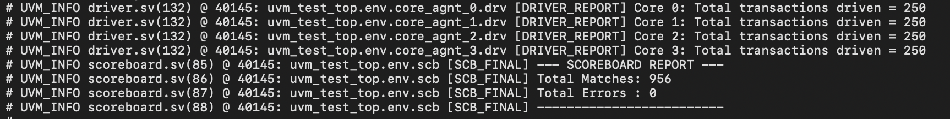
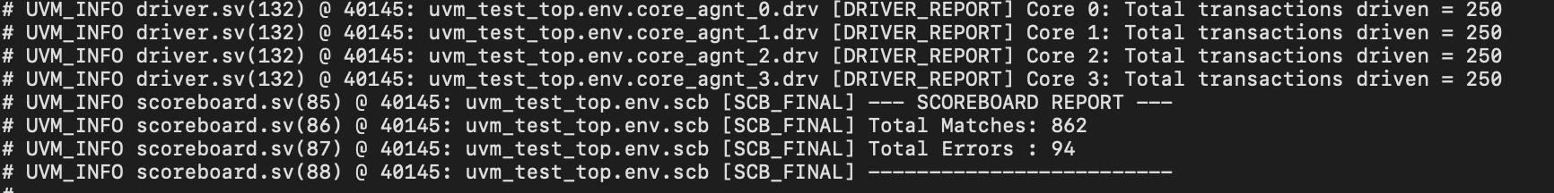
Sample Results
No Bug
Bug 1 - Arithmetic ALU (op:1 Addition)

Slide 10
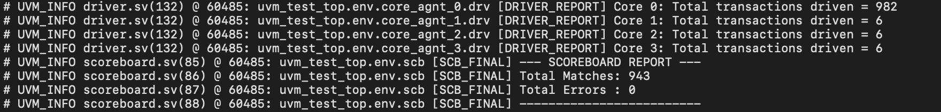
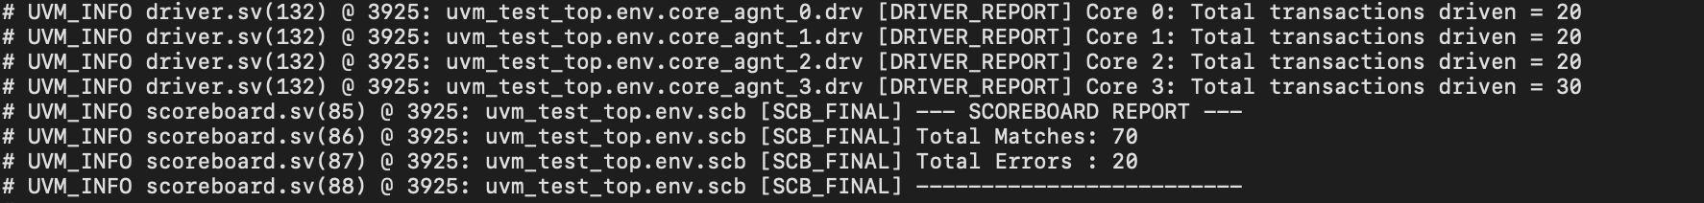
Cont…
Bug 2 - Arbiter Fairness
Bug 3 - Memory Coherency

Slide 11
Team Contributions
J
Janvier Mpfizi Rutihunza
RTL Design Lead
Driver, Monitor & Sequencer
mp_driver: drive_tx() + grant_wait loop
mp_monitor: @(gnt) capture & forward
mp_agent: seqr + drv + mon
4-core RTL & round-robin arbiter
Shared memory subsystem design
F
Frezewd Debebe
Verification Environment Lead
Sequence, Test & TB_TOP
mp_env: core_agnt[4], scb, cov
mp_test / mp_alu_test / mp_coverage_test
tb_top: DUT instantiation & interface
mp_scoreboard: predict + compare
Virtual sequences (mp_vseq)
S
Sal Esmaeil
Sequences & Coverage Lead
Bug Injection
Bug 1: ADD computes A−B (arithmetic)
Bug 2: Arbiter locked to Core 0 only
Bug 3: STORE silent memory corruption
Coverage model: 89 bins, CROSS_CORE_OP
100% coverage closure (clean DUT)
All members contributed to: Testing • Code Review • Documentation • Presentation

Slide 12
References
[1] Siemens | UVM Basics https://www.youtube.com/watch?v=-WmTiQiTwco&list=PLWPf2kTT1_Z20pIAfQJ2qyNXLCLM1kUPB
[2] Semiconductor Club https://www.youtube.com/watch?v=JRfmSv5INP8
[3] GitHub https://github.com/ahmd-kamel/Memory-Verification-using-UVM/blob/main/Class%20Based%20Env/coverage.sv
Course Material ECE-593: Fundamentals of Pre-Silicon Validation | Prof. Venkatesh Patil | Portland State University | Winter 2026

